Slide 1
Free Space Optical Communication PROJECT PROPOSAL
Marine Infrared Free Space Communication Relays using UAVs

Slide 2
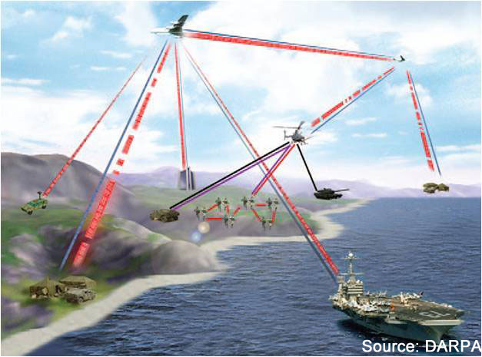
Terminology
Free Space Optical Communication: Turn lasers on/off to represent bits, operating in GHz range
Infrared: Near optical light wavelengths
UAVs: Unmanned Aerial Vehicles (drones)
FANET: Flying ad hoc Network

Slide 3


Buckle Up
https://d37iyw84027v1q.cloudfront.net/na/bradyid/BradyID_Large/124463.jpg
https://images.wsj.net/im-159769?width=1280&size=1
Notes:
This is a highly technical topic, I will be going quickly

Slide 4
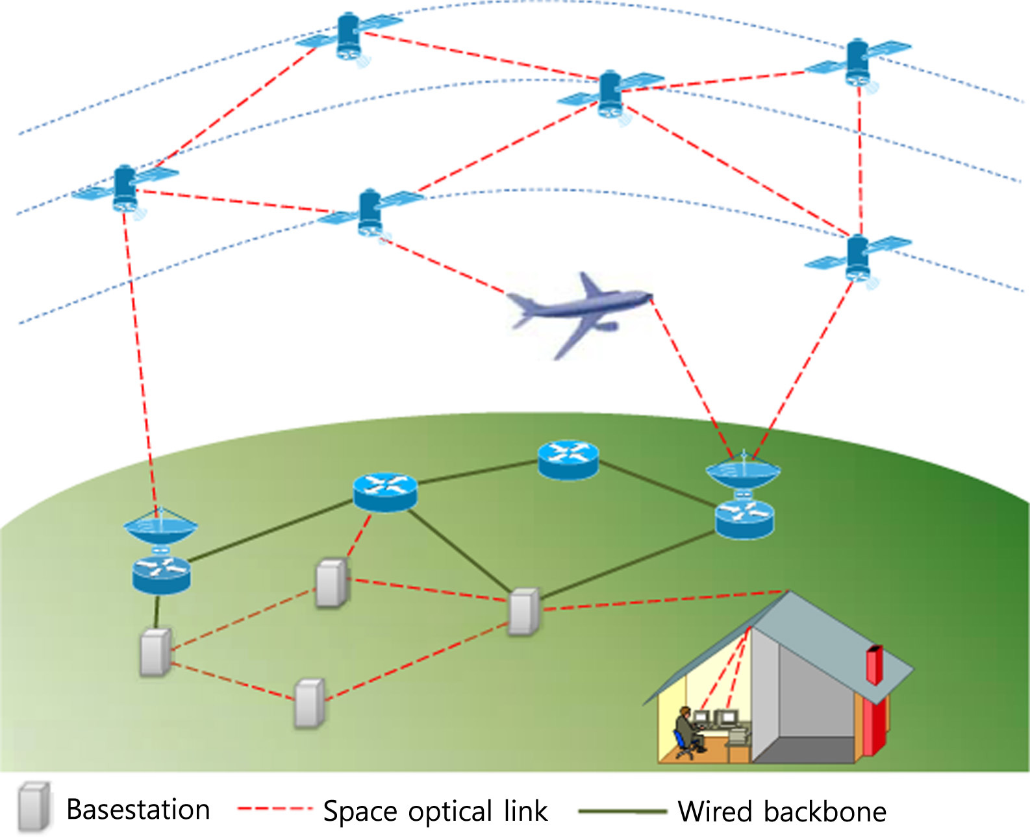
What?
Source: Keun Son, Shiwen Mao, ‘A Survey of Free Space Optical Networks” in Digital Communications and Networks, pg 67-77. https://doi.org/10.1016/j.dcan.2016.11.002.
Red circle added for clarity
Notes:
Relay for over the horizon / over obstacles communication using optical comm as FSO is limited to line of sight

Slide 5
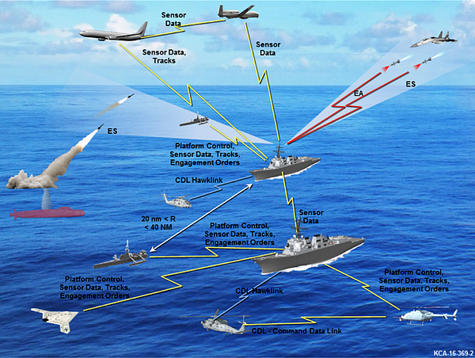
Why
https://www.afcea.org/content/?q=Article-us-navy-runs-interference-signals-conflict
Notes:
Naval requirements
High bandwidth
RF Denied environments
Low Side lobe
Optical is perfect but has line of sight issues ; must use relays for over the horizon / over obstances / large networks
Like all defense, knock on benefits with FANETs in disaster areas (use in FEMA)

Slide 6
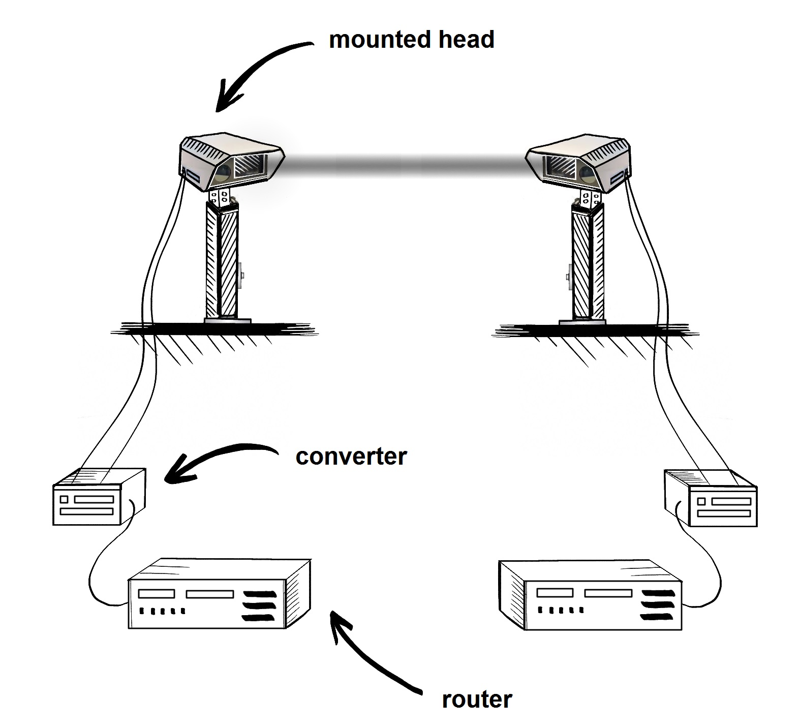
Project Scope
Novel SATA 10GHz setup
New motorized scanning system
10GHz testing system
Control System
Homing laser
Hardware construction
  Transceiver
  Control System
  Redesign of media converter
https://encyclopedia.pub/3726

Slide 7
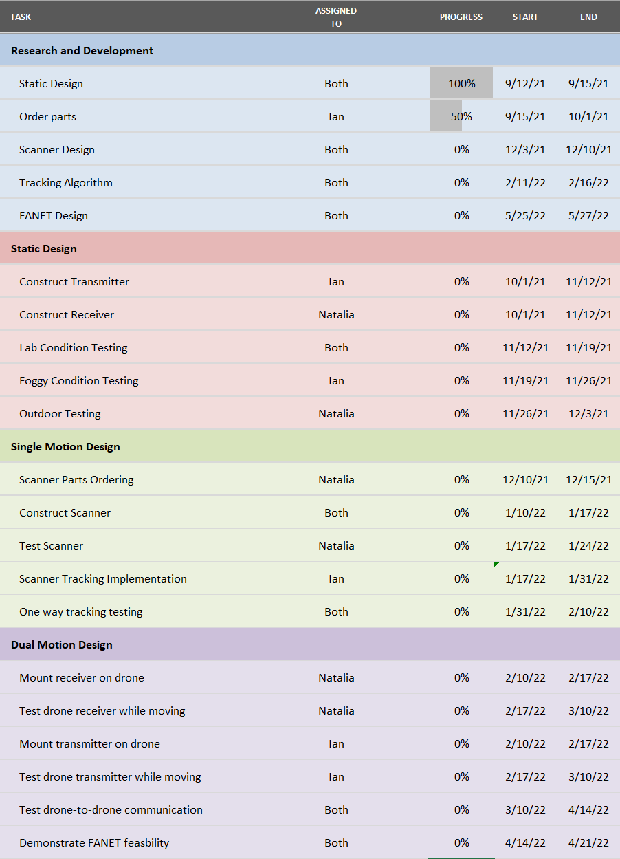
Timeline

Slide 8


The Team
Notes:
Ian: Drivers for SATA connections and Transmit system
Natalia: Testing software and receive system

Slide 9
Questions?

